Slide 1




Integrated
Electronic
Enterprise
GENIUS SOFTWARE
GENIUS SOFTWARE
Business Management
Business Intelligence
@ your fingertip

Slide 2

Key Discussion Points
Problem Statement
Platform Offering
Backgrounds
Prototype
Game Changers
GENIUS SOFTWARE
Business Management
Business Intelligence
@ your fingertip

Slide 3
Pharmaceutical Value Chain
Discover
Develop
Manufacture
S&M
Distribute
Manage Product
I
N
D
N
D
A
Molecule
Biologic
Formulation
Clinical Trials
Drug Product
Supply Chain
Promotion
Logistics
Cold Chain
Reviews
Complaints
Recall
I
N
D
Investigational New Drug
Begin Human Clinical Trials
N
D
A
New Drug Application
Drug Marketing License Approved
GENIUS SOFTWARE
Business Management
Business Intelligence
@ your fingertip

Slide 4

S/IVVY GLO BE
Business Management
Business Intelligence
@ your fingertip

Slide 5

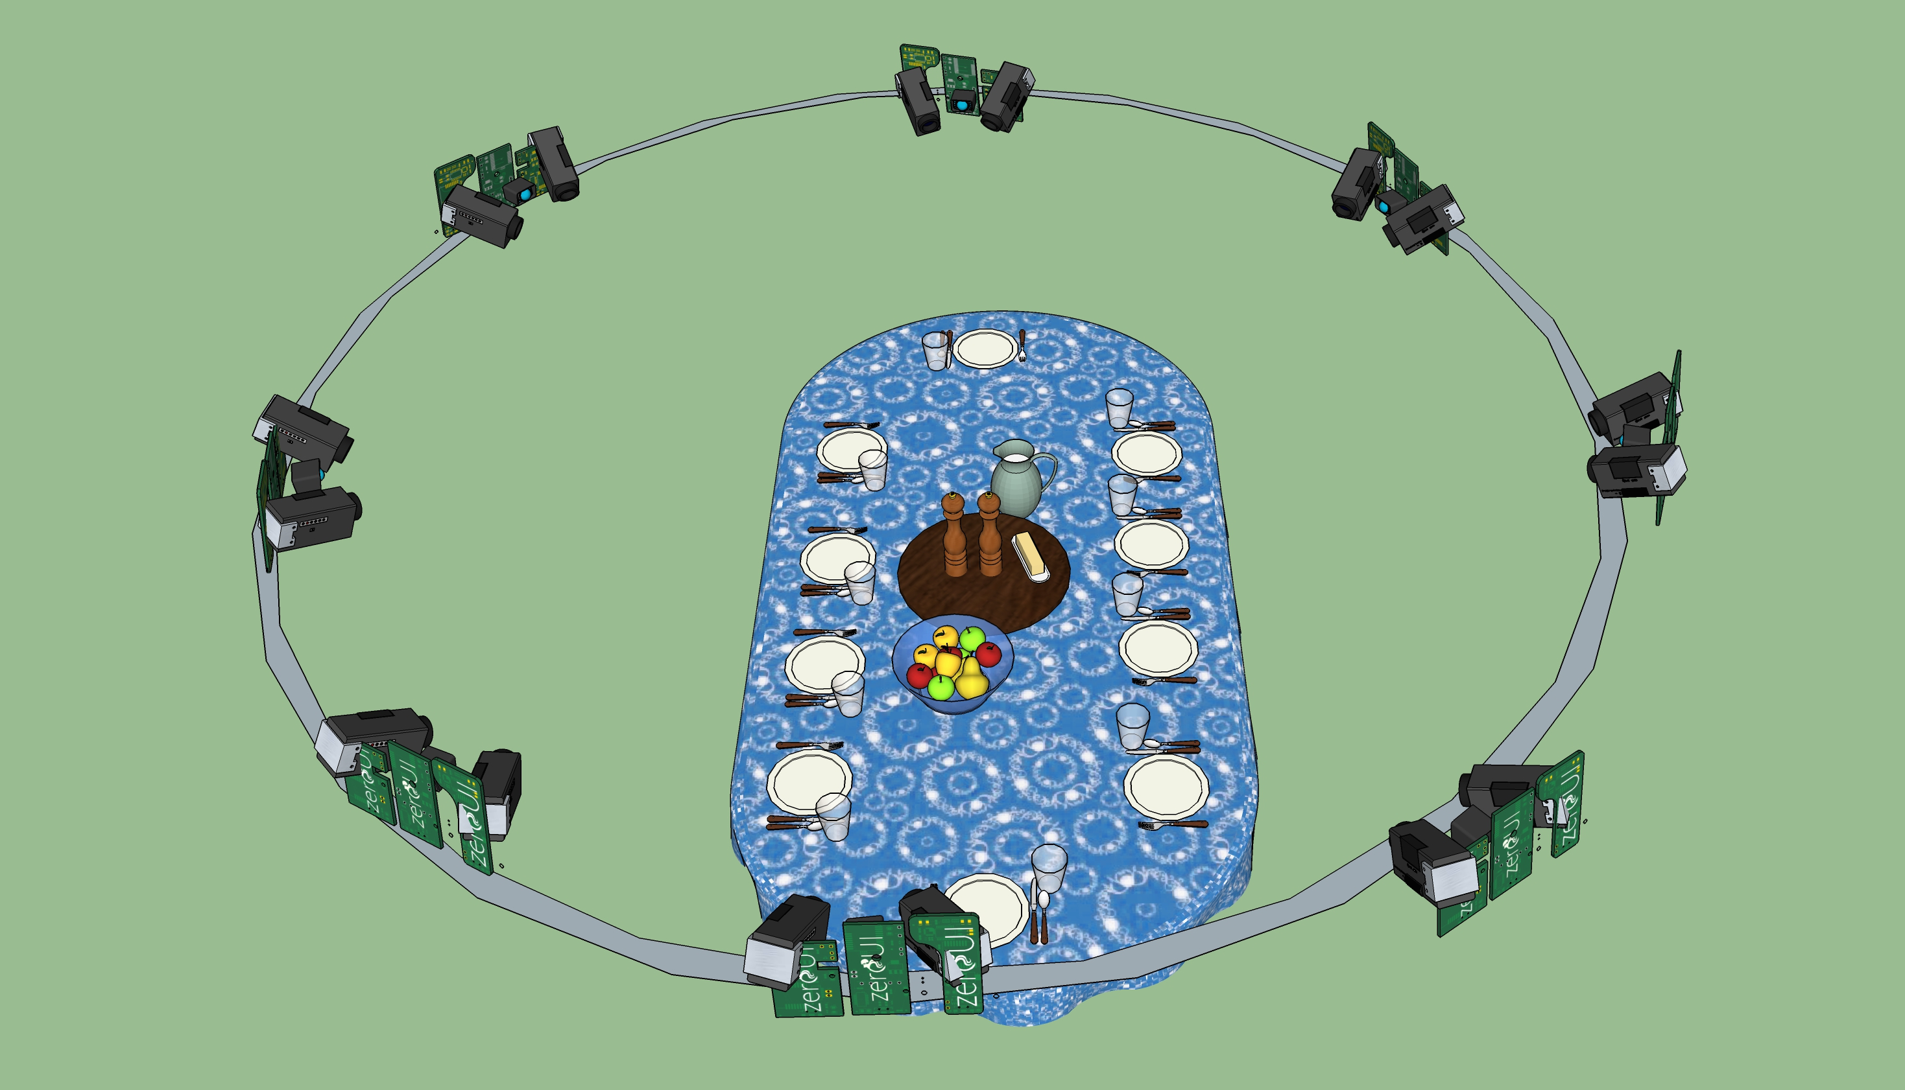
Purpose: - Build 3D scene in Real time - Track each object in Real time - Recognize and label each object in Real time - Do Quality Control

Slide 6

Your Background
- Active / Passive Stereo-Vision, (or other image processing, computer vision skills) for data acquisition
- Point Cloud Registration for data consolidation
- Point Cloud segmentation for isolating objects
- Mesh creation from Point Cloud, for visualizing objects.
- Point Cloud recognition for labeling objects
- Point Cloud Tracking for inventory creation

Slide 7

Your Background Continued
??????? ??????????
A Passionate for Cutting Edge Technology
Expert in Point Cloud Computation & Software Writing to help build prototype
Be Integral Helping Build Game Changing Prototype
Routine life is not your cup of tea
…. And Whatever You Want to Bring
GENIUS SOFTWARE
Business Management
Business Intelligence
@ your fingertip

Slide 8
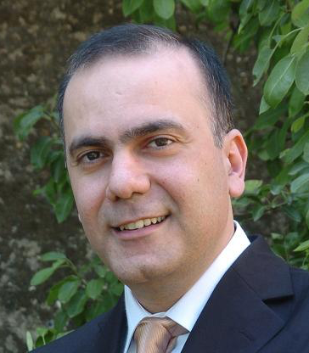
Our Backgrounds
Habib Abi-Rached (Chief Technology Officer: CTO & Founder)
Ph.D in Computer Vision & Graphics (University of Washington)
Renowned Researcher at Nasa JPL, Ford & Charles River
Brings Unique Expertise at Intersection between Optical Capture and Computational Processing
Expert in IoT Devices, Data Analytics & Data Visualization
Disruptive Contributions at General Electric, GE Aviation & Healthcare
GENIUS SOFTWARE
Business Management
Business Intelligence
@ your fingertip

Slide 9

Our Backgrounds (Continued)
Charbel Achkar (Chief Executive Officer: CEO & Founder)
Chemical Engineering Education & Experience Background
Over 20 Years of Altruistic Informatics Consultancy to Fortune 100 Pharmaceutical & Biotech Companies (Pfizer, Johnson & Johnson, GSK…)
Proven Track Record of Solving Complex Problems that cause Business Disruptions and/or Regulatory Compromises
Visionary & Srategist
GENIUS SOFTWARE
Business Management
Business Intelligence
@ your fingertip

Slide 10
Questions?
Charbel Achkar Charbel@geniuSoftware.com
M: +1 (415) 702-7743
THANK YOU
S/1V VY GLOBE
Business Management
Business Intelligence
@ your fingertip

